Slide 1
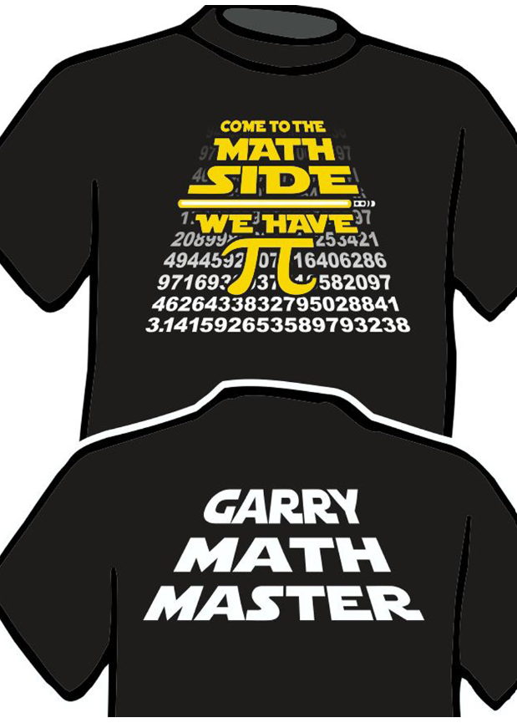
+
Ma h Matters
Rules and Directions
Past Prompts
Submit answers here
Counting Squares
Launch: How many squares are there in the 4 by 4 grid? All squares must have corners (vertices) on the points on the grid. Did you find 14? Could you find more (vertical/horizontal squares vs diagonal squares)?
The task: How many grid squares are there on different sized square grids? How many squares on a 2 by 2 grid? A 3 by 3 grid? A 5 by 5 grid? What about a 10 by 10 grid?
Challenge: Can you write an equation to predict the number of squares in any size square grid?
December 2020 Click for printable dot paper
Congratulations to last month’s
Garry Math Masters!
Correctly complete and submit the problem for December and see your name here in January.
You could win a Garry Math Master T-shirt.
Good luck!

Slide 2
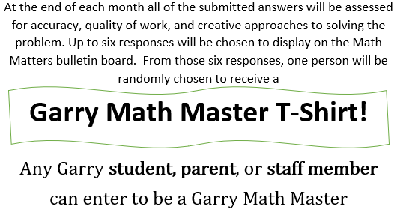
Do you want to be a Garry Math Master?
Here’s how:
Copy or print this month’s prompt from the virtual bulletin board.
Complete the problem to the best of your ability, showing your work on separate paper or through tech.
Submit your work to Kylag@spokaneschools.org
Back to the Main Board

Slide 3
Submitting Answers
Email a picture of your work and solution to
Kylag@spokaneschools.org
Back to the Main Board
Back to the Main Board

Slide 4
Back to the Main Board

Slide 5
Past Prompts
September 2019
November 2019
December 2019
February 2020
Back to the Main Board

Slide 6
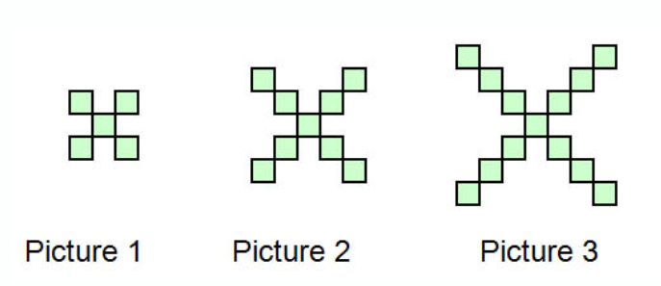
September 2019
How many squares are there, in the
100th picture?
The nth picture?
You may model your work using pictures, tables, graphs, etc.
Back to Past Prompts
Back to the Main Board

Slide 7
November 2019
What’s the Secret Code?
1. It is between 8,500 and 8,800.
2. When multiplied by 8, the result is a whole number.
3. The digit in the hundreds place is ¾ the digit in the thousands place.
4. The sum of all digits in the number is 26.
5. The digit in the hundredths place is 200% of the digit in the tenths place.
6. There are no zeros in the decimal places.
What code numbers fit these clues?
Write one more clue so that there is only one possible code number.
Back to Past Prompts
Back to the Main Board

Slide 8
December 2019
A Penny problem
Consider a collection of pennies with the following constraints:
When the pennies are put in groups of 2 there is one penny left over.
2) When they are put in groups of three, five and
six there is also one penny left over.
3) But when they are put in groups of seven there
are no pennies left over.
How many pennies could there be?
Back to Past Prompts
Back to the Main Board

Slide 9
February 2020
Back to Past Prompts
Back to the Main Board

Slide 10
December 2020
Counting Squares
Launch: How many squares are there in the 4 by 4 grid? All squares must have corners (vertices) on the points on the grid. Did you find 14? Could you find more (vertical/horizontal squares vs diagonal squares)?
The task: How many grid squares are there on different sized square grids? How many squares on a 2 by 2 grid? A 3 by 3 grid? A 5 by 5 grid? What about a 10 by 10 grid?
Challenge: Can you write an equation to predict the number of squares in any size square grid?
.
Click for printable dot paper
Back to the Main Board

Slide 11
Back to the Main Board

