Slide 1
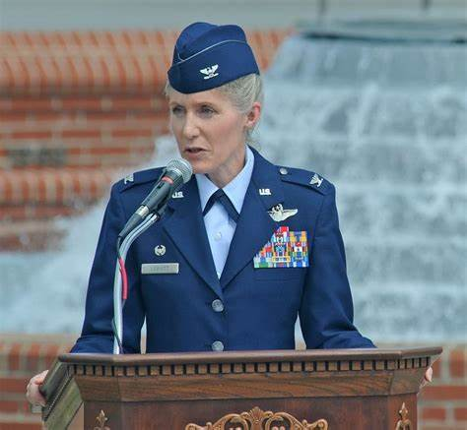
1
What is the rank?
What is the grade? E- or O-?

Slide 2
2
What is the rank?
What is the grade? E- or O-?

Slide 3
3
What is the rank?
What is the grade? E- or O-?

Slide 4
4
What is the rank?
What is the grade? E- or O-?

Slide 5
5
What is the rank?
What is the grade? E- or O-?

Slide 6
6
What is the rank?
What is the grade? E- or O-?

Slide 7
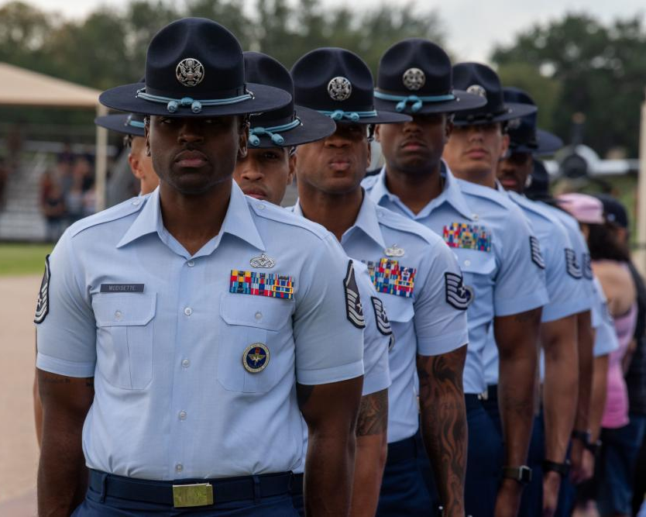
7
What is the rank?
What is the grade? E- or O-?

Slide 8
8
What is the rank?
What is the grade? E- or O-?

Slide 9
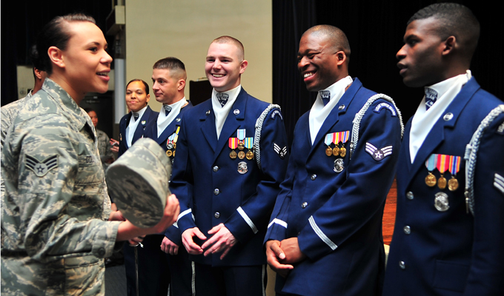
9
What is the rank?
What is the grade? E- or O-?

Slide 10
10
What is the rank?
What is the grade? E- or O-?

Slide 11
11
What is the rank?
What is the grade? E- or O-?

Slide 12
12
What is the rank?
What is the grade? E- or O-?

Slide 13
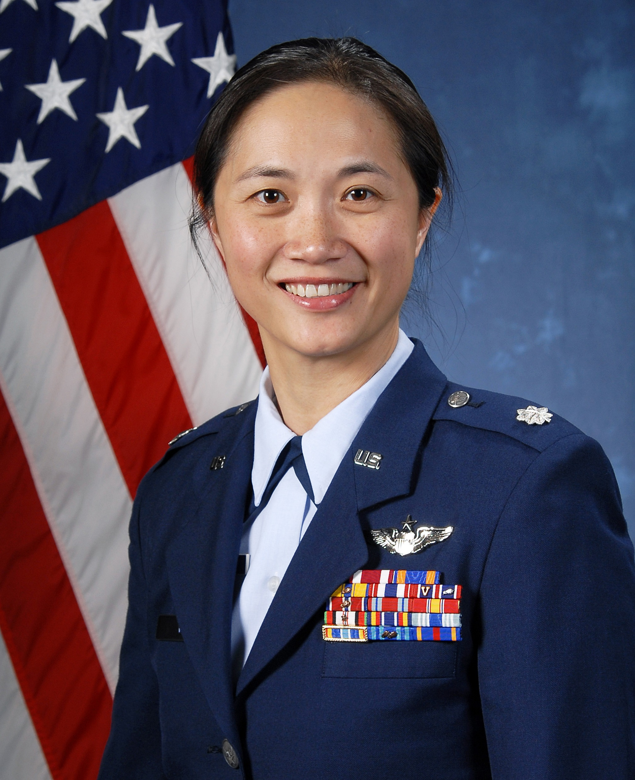
13
What is the rank?
What is the grade? E- or O-?

Slide 14
14
What is the rank?
What is the grade? E- or O-?

Slide 15
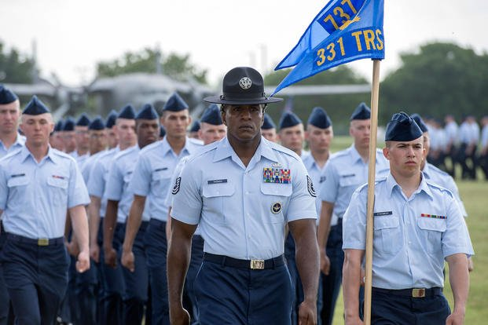
15
What is the rank?
What is the grade? E- or O-?

Slide 16
16
What is the rank?
What is the grade? E- or O-?

Slide 17
17
What is the rank?
What is the grade? E- or O-?

Slide 18
18
What is the rank?
What is the grade? E- or O-?

Slide 19
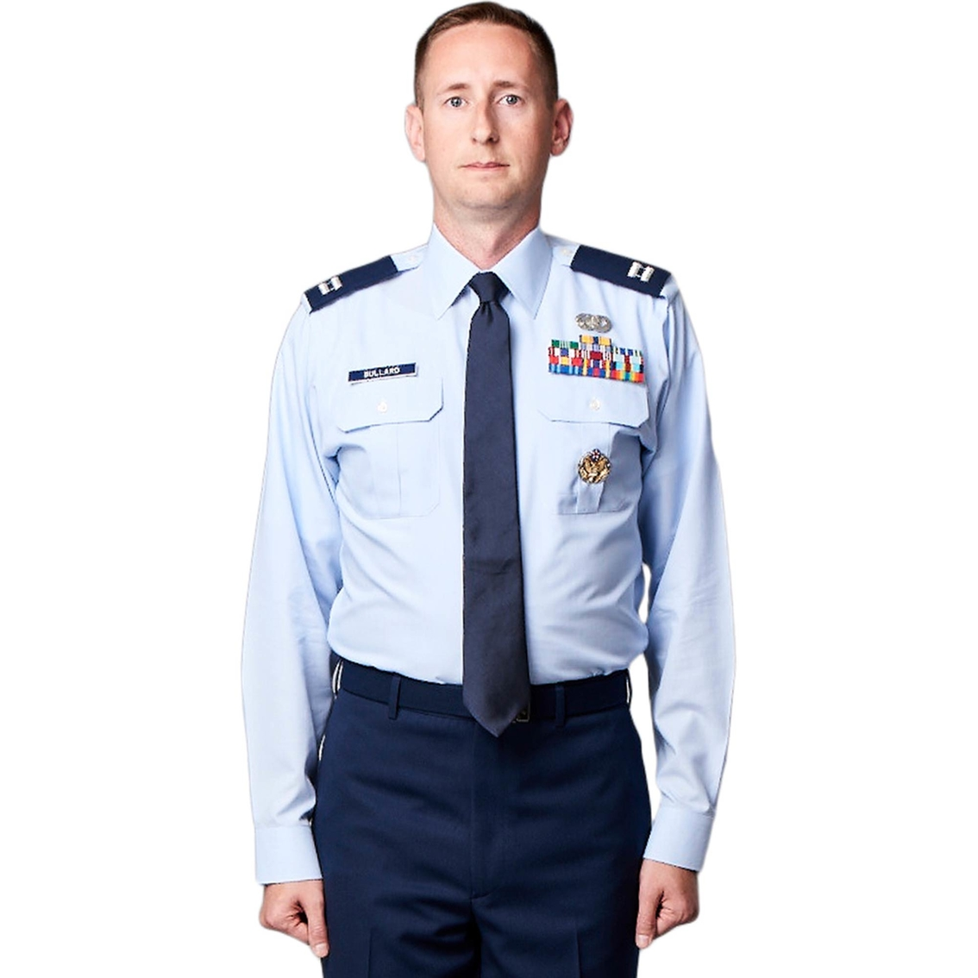
19
What is the rank?
What is the grade? E- or O-?

Slide 20
20
What is the rank?
What is the grade? E- or O-?

