Slide 1

While you wait for our presentation to begin, please think of a PASSWORD for your SPS District Accounts:
Must contain 15 characters
Must contain a combination of upper- and lower-case letters
Must contain a number
Must contain a special character
Cannot contain your name
Cannot contain your birthdate

Slide 2

OUR MISSION
Every SPS student engages in joyful and challenging learning experiences throughout their educational journey that prepare them to become lifelong learners and graduate with the knowledge, skills, habits, agency, and community connections they need to pursue their passions and desired post-secondary opportunities.
SPS PROMISE
Every SPS student has a dream, access, and opportunity for a happy and successful future.
Notes:
Welcome slide

Slide 3
Strategic Plan 2022-28
We worked with parents, families, staff, students, and the larger Spokane community to develop this strategic plan, which will guide and inform our work for the next six years.
To ensure we are meeting our commitment to creating a collaborative learning community where every student and every staff member knows that they belong, we outlined these guiding principles:
Equity
Being student-centered
Inclusion
Innovation
Trust and collaboration

Slide 4
Introductions
Sub Services
Additional Support
Bethany Fields
  Classified Substitute Application & Selection Specialist
  BethanyF@spokaneschools.org
  (509) 354-5980
Shelly Sines
  Substitute Services Manager
  MichelleSi@spokaneschools.org
  (509) 354-7230
Substitute HELP Desk
  SubDesk@spokaneschools.org
  (509) 354-7343
Diana Arnold
  Secretarial Support Supervisor
  DianaA@spokaneschools.org
  (509) 354-5954
Sabrina McDermott
  Nutrition Services/Mosaic
  SabrinaM@spokaneschools.org
  (509) 354-5976
Kimberly Rogge
  PowerSchool
  KimberlyRo@spokaneschools.org
  (509) 354-7397
Amber Battin
BECCA/Truancy Liaison
AmberB@spokaneschools.org
(509) 354-6473

Slide 5
Appropriate Behaviors
It’s the law!

Slide 6
Mandatory Reporters of Suspected Child Abuse (Procedure 3421; RCW 26.44.030)
When any professional school personnel has reasonable cause to believe that a child has suffered abuse or neglect, a report shall be made to the proper Law Enforcement Agency or to Child Protective Services (CPS) with 48 hours.
Be sure to notify your building administrator and counselor.
Be sure you know your building’s process for making the report(s).
Be sure you document:
  Date
  Time
  Report Number
Contact information:
  CPS – (509) 363-3333
  Crime Check – (509) 456-2233
Click here to access the Professional Code of Conduct
Notes:
9 & 10 are the same slide???

Slide 7
    Maintaining Professional Staff/Student Boundaries (Pol/Pro 5253)
    The board expects all district staff to maintain the highest professional standards when they interact with students. District staff are required to maintain an atmosphere conducive to learning by constantly maintaining professional boundaries. See examples below.
Being alone with an individual student out of the view of others;
Inviting or allowing individual students to visit the adult’s home;
Visiting a student’s home;
Sending or soliciting email, text messages or other electronic communications to the student, except when the communication relates to school business, and the building administrator or supervisor has consented to such communications; and/or
Social networking with students for non-educational purposes.
RCW26.44.020: Abuse or Neglect means sexual abuse, sexual exploitation, or injury of a child by any person under circumstances which causes harm to the child’s health, welfare, or safety or the negligent treatment or maltreatment of a child by a person responsible for or providing care to the child.
District Policy 2022: Electronic Resources and Internet Safety​
This policy covers the use of electronic resources and appropriate online behavior.

Slide 8
Harassment, Intimidation & Bullying: (Policy 3207)
The district is committed to a safe and civil educational environment for all students that is free from harassment, intimidation, or bullying. As defined in legislation, “Harassment, intimidation, or bullying” means any intentional, electronic, or written, verbal, or physical act, including but not limited to, one shown to be motivated by race, color, religion, ancestry, national origin, gender, sexual orientation including gender expression or identity, mental, physical, or sensory handicap, or other distinguishing characteristics, when the act:
  Physically harms a student or damages the student’s property;
  Has the effect of interfering with a student’s education;
  Is so severe, persistent, or pervasive that it creates an intimidating or threatening educational environment; or
  Has the effect of disrupting the orderly operation of the school.
  Other distinguishing characteristics” can include but are not limited to physical appearance, clothing or other apparel, socioeconomic status, and weight.
  Any school staff who observes, overhears, or otherwise witnesses harassment, intimidation or bullying or to whom such actions have been reported must take prompt and appropriate action to stop the harassment, intimidation, or bullying and to prevent its reoccurrence.
Allegations indicating a potential violation of procedure must be reported to your Supervisor and District Compliance Officer (Melanie Smith)

Slide 9
Sexual Harassment Policy (Policy 5011)
This district is committed to a positive and productive working environment free from discrimination, including sexual harassment. Sexual Harassment means unwelcome conduct or communication of a sexual nature. The District prohibits sexual harassment of district employees by other students, employees or third parties involved in school district activities.
Civility Policy (Policy 5117)
The Spokane School District believes that a safe, civil environment is essential to high student and staff achievement, to the free exchange of ideas central to a quality educational process, and to the development of youth as thoughtful participants in our democracy. Conversely, uncivil conduct, like other forms of disruptive behavior interferes with a student's ability to learn and a school's ability to educate its students.

Slide 10
Drug-Free Schools, Community & Workplace:
Policy 5201
Prohibited Behaviors​
  Reporting to work under the influence of alcohol, illegal and/or controlled substances, including marijuana​.
  Using, possessing, transmitting alcohol, illegal and/or controlled substances, in any amount, in any manner, and at any time in the workplace​.
  Using district property or staff member’s position to make or traffic alcohol, illegal and/or controlled substances​.
Notification Requirements​
  If a prescribed or over-the-counter medication could compromise the safety of the staff member, students or the public, follow appropriate personnel procedures.​
  Convictions under any criminal drug statute violation must be provided no later than 5 days after such to the district.​
Disciplinary Action​
  Violation of any aspect subject to disciplinary action, which may include termination.​
  Reinstatement may require satisfactory completion of a drug rehabilitation or treatment program.

Slide 11

Who do I contact?
  The building administrator/principal or your supervisor
HIB
  Melanie Smith, Director of Student Services – (509) 354-7284
Title IV & Discrimination Officer:
  Jodi Harmon – (509) 354-7344
HR Employee/Labor Relations:
  Richelle Swartz, Director – (509) 354-5907
  Laura Sumner, Director – (509) 354-7285
  Jason Lesley, Manager – (509) 354-7262

Slide 12

Safe Schools Training
Safe Schools is mandatory training for ALL employees and must be completed within 30 days of employment.
  A link to your Safe Schools account will be sent to your District email address following hire, and annually thereafter (September).​

Slide 13
L & I claims
All injuries must be reported.
All injuries are to be reported to supervisor and online incident report completed as soon as safely possible.
Complete the Incident Report online for ALL Injuries regardless if medical treatment is required or not.
  spokaneschools.org/staff - Forms → Safety & Risk Management → Online Incident/Injury Report
  Injury Report Page
Contact Tracy Adair in Human Resources if you have any questions or concerns.

Slide 14
Mosaic & Intouch
Sabrina McDermott and Diana Arnold

Slide 15
PowerSchool & BECCA Law
Kim Rogge & Bethany Fields

Slide 16
The BECCA Law
The Becca Law (RCW 13.32A) was enacted by the Washington State Legislature to:
Protect children who are endangering themselves
Keep families together through assessment and treatment services
Provide tools for schools, parents and Juvenile Court to keep children in school
Hold children and parents accountable to the order of the Court
Schools must file a truancy petition with Juvenile Court when a child has more than seven unexcused absences in a month or fifteen in a school year. The parent will be notified of the truancy petition unless the child is attending an approved private school or home-based instruction.

Slide 17
The BECCA Law
The law makes attendance compulsory for all children ages eight to eighteen unless the child:
Is sixteen and is engaged regularly/lawfully in a useful occupation and parent agrees that the child should not be required to attend school
Is emancipated
Has met graduation requirements
Has received a certificate of educational competence
Is receiving home-based instruction.

Slide 18

Secretarial Substitute What to Expect

Slide 19
Secretarial Substitute Hourly Rates
Regular - $18.35988 per hour
Most secretarial jobs are 5 to 8 hours per day
Notes:
CM
Direct deposit form
Web resource
School calendar resources

Slide 20
Payroll Information
Payday is the last working day of the Month.
The pay period begins on the 11th and goes through the 10th of the following month.
  Ex: Your October paycheck will reflect hours worked from September 11th through October 10th .
If the 11th falls on a weekend, the pay period does not start until the next working day.
Employees have the choice of receiving a pay card or direct deposit.
Any payroll questions can be directed to the Shelly Sines at:
  Phone – 509 354-7230
  Email – michellsi@spokaneschools.org

Slide 21
I-1433
You accumulate one hour of sick leave for every 40 hours worked.
Your balance is listed on your paystub in Employee Online.
When is it appropriate to use Sick Leave?
  You (the employee) are sick.
  Someone in your immediate family is sick and needs your care.
To access your sick leave, you must fill out an exception form and turn it into Shelly Sines.
  Spokaneschools.org/staff - Forms> Payroll > Exception Hours Timesheets > General

Slide 22
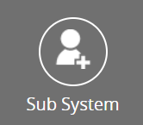

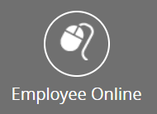
Technology
  FRONTLINE (formerly AESOP)
    This is used to accept jobs and record hours worked.
      Email - subdesk@spokaneschools.org
      Call - (509) 354-7343
  District E-mail
    Email is public record and is subject to review by court order, or public disclosure request:
      Do not use personal email for district/work related communication and do not use work email for personal use.
    Call Tech Services at 354-7600 for assistance.
  Employee Online (EO)
    This our payroll server.
    Access EO through the SPS Website.
    Your annual Letter of Assurance (LOA) will be sent to your Employee Online account.

Slide 23
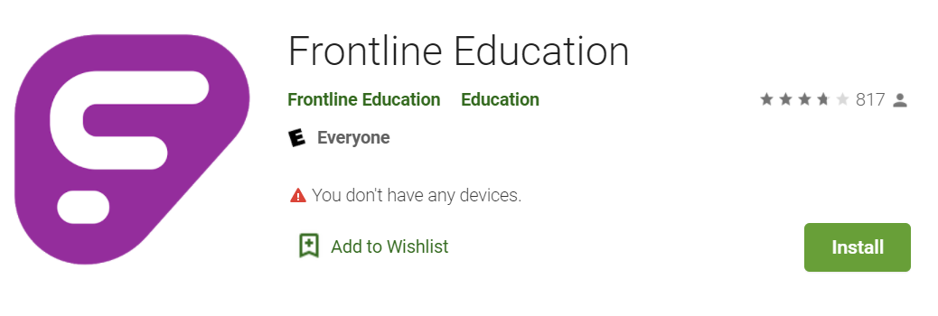
Frontline Mobile App
Download the Frontline Mobile App.
It’s FREE to Spokane Public School Employees.
You do not need a district code.
You need to set up your account via the web before you can
set up the mobile app.

Slide 24

Preparing for your Day
Know the start time of your assignment – double-check Frontline to ensure you are still assigned.
Know where you are going and pre-determine your route.
Dress appropriately
Follow the instructions provided and ask questions when necessary.
Have a positive can-do attitude.
Notes:
Find/save school numbers in your cell phone.

Slide 25

Work Schedule
High School 8:00 AM – 2:30 PM
Elementary 8:30 AM – 3:00 PM
Middle School 9:00 AM – 3:30 PM
Late start Mondays apply to students only!
Arriving early is always advantageous.
Split assignments can be difficult.
Running Late? Call to alert the Office Manager or call the Sub Desk so we don’t worry about you!
MAKE SURE YOU ARE AWARE OF LATE START DAYS
AND OTHER ITEMS ON THE
2022-23 SCHOOL CALENDAR.

Slide 26
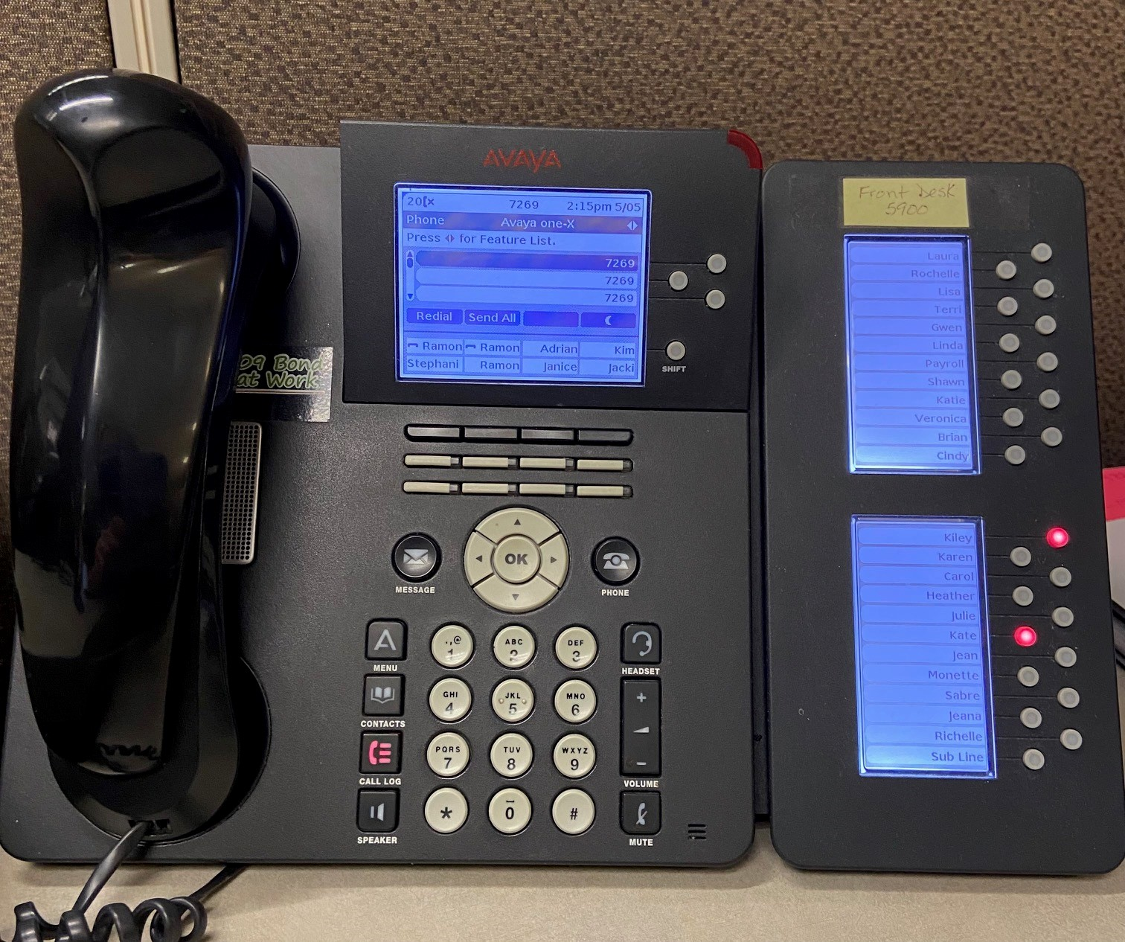
PHONE SYSTEM

Slide 27
Phone System – How To
To Dial Out – Must dial 9 and then phone number.
  Example – Phone number is (509) 354-7343.
    Dial 9 509 354 7343
To Dial within District
  You do not need to dial 9 first.
  Just dial the last 4 digits of the number.
    Ex. 354-5980 – You only need to dial 5980.
How to Answer a phone call:
  Ask the other secretaries how they prefer you answer the phone.
    Example - Good Morning, Francis Scott Elementary, this is . . .
  If you do not know, do not guess! Take their name and number and tell them you will call them back.

Slide 28
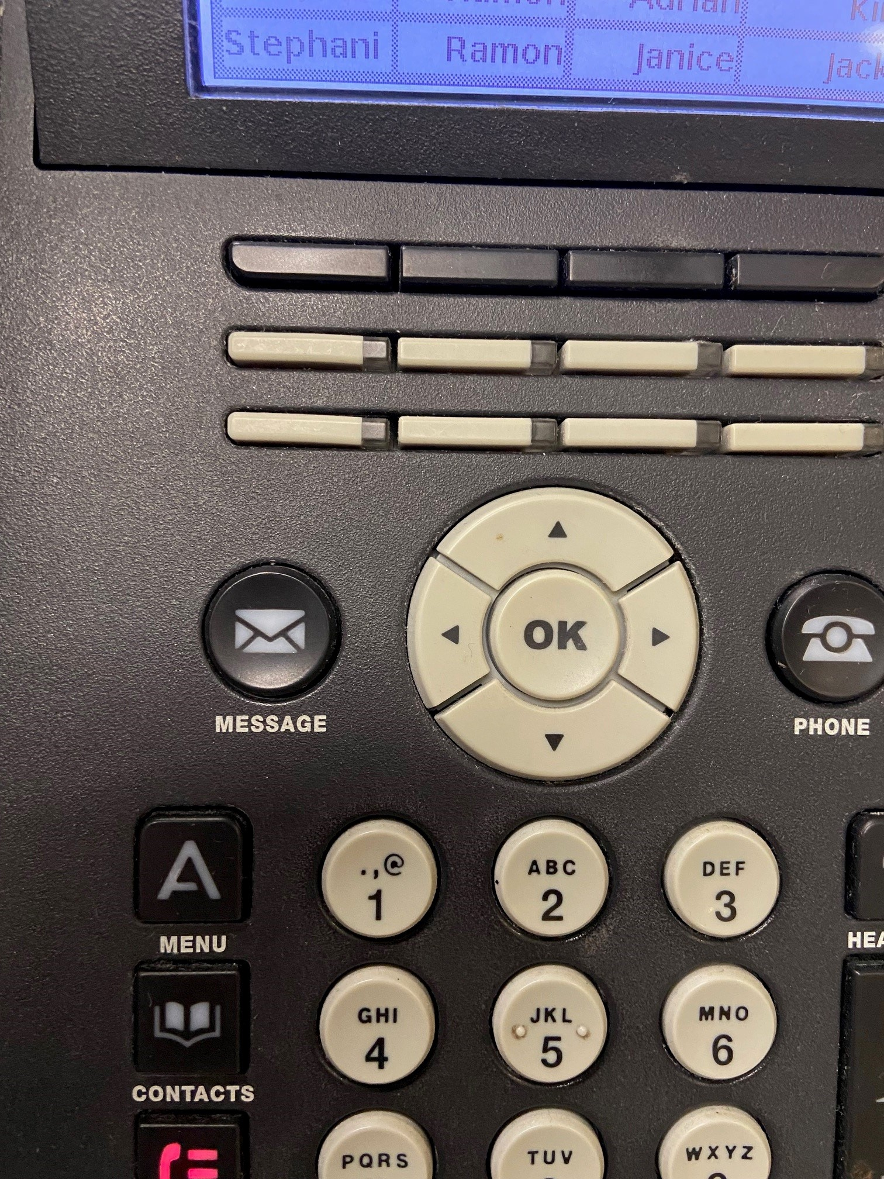
How to Check Voicemail
Push the Message Button and put in password and #.
Ask the Office Manager for the password.

Slide 29
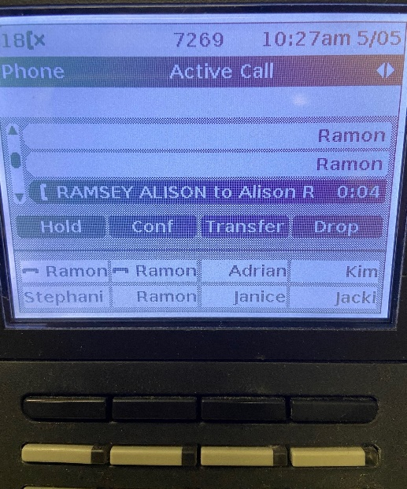
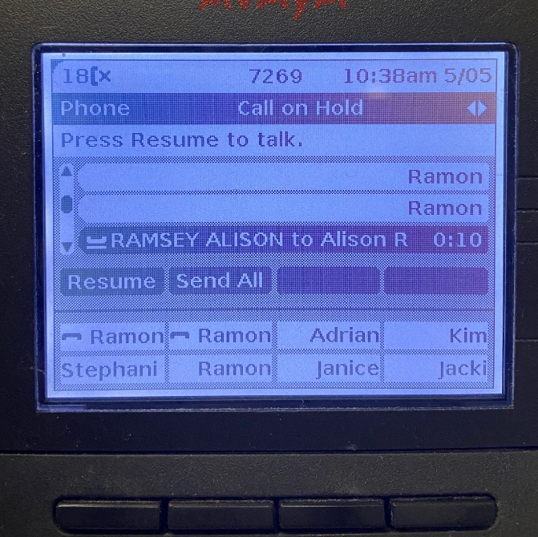
How to Put a Call on Hold & Take off Hold
PUT CALL ON HOLD
Push the black button on the phone below the word – HOLD.
TAKE CALL OFF HOLD
Push the black button below the word - RESUME

Slide 30

How to Transfer a Call
Push the black button on the phone below the word Transfer
Dial the extension.
You can announce the call or just hang up.

Slide 31
SSPE –
Single Secure Point of Entry
Every location has SSPE. It is the responsibility of district secretarial staff to monitor entry to the building.
Ask how the building processes visitors
  Screen outside in vestibule, or allowed in?
  Verify name in PowerSchool
Ask how the building processes late student arrivals
  Straight to class, or check in?
Ask how the building processes student early release
  Allowed to wait inside, or send students out?
Trust your “spidey-sense”

Slide 32

“The kids who need the most love will ask for it in the most unloving ways.”

Slide 33
De-escalation strategies
Stand at an angle to the student.
Do not invade their personal space.
Do not maintain a rigid stand or cause the student to feel cornered.
Do not touch the student.
Break eye contact with the student to reduce the suggestion of aggression or control.
Keep calm, neutral, and be confident.
Be an empathetic listener, do not “assume” what a student is thinking.
Display sincerity, don’t make threats, or set limits you cannot enforce.
Clarify communication and ask for specific responses.
Ignore challenges and comment only on student’s behaviors.
Keep language around “choices” followed by consequences (positive and negative).
Walk Away for a minute, come back and re-engage.

Slide 34
De-escalation strategies - for you
Remember you are the adult and can lead by example by showing a student how to handle big emotions
  Do breath-work together
  Do a time out together
  Do a redirection activity together
Do not touch students, no matter what
Recognize when you are going into “parent-mode”
Ask for help
Take a break
Switch tasks to redirect your brain

Slide 35
Additional Paid Training Opportunities
  Training is optional and voluntary, and up to four (4) hours of pay will be available annually; additional training may be attended without pay.
A newly hired substitute may receive four (4) hours of paid job shadow training in lieu of the district provided training.
Types of Training Available
  Mosaic – Lunch payment system
  InTouch – Online Payment processing system
  Shadowing
How to Access Trainings/Shadowing
  Contact Bethany Fields– bethanyf@spokaneschools.org

Slide 36
THINGS TO DO
Upon Arrival
  Report to the public or main office.
  Sign in and introduce yourself to office staff.
  Collect a Radio or Badge with access, if necessary, and any sub plans.
  Clarify cell phone usage rules for specific building.
End of Day
  Return Radios and Badge with access to the Office Manager.
  Leave a note on how your day went, things to know, etc.
  Sign out for the day.
Notes:
Find/save school numbers in your cell phone.

Slide 37
Ensure Success
Be prepared to work directly with students.
Follow instructions to the best of your ability.
Communicate clearly and often with others in office.
Have a positive can-do attitude.
Be Proactive:
  Answer Phones without being asked.
  Assist with granting entry to building.
  Offer to assist with students or projects.
This is your opportunity to shine, especially if you are interested in
applying for full-time positions.
.

Slide 38
Ideas of tasks you offer to help with:
Make student registration packets
Make photocopies of school forms
Make new updated versions of school forms
Wipe down or dust the office
Inventory supplies
Restock paper
Put mail in boxes

Slide 39
Housekeeping
Resignation or new job
  Please send an email/letter advising us of your status change as soon as possible.
Minimum 10 days of subbing per year to remain a substitute.
Keep your contact information in Frontline updated!
We will only send email to your school district email and not to your personal email.

Slide 40
Final To Do List
Watch for emails from SafeSchools, Frontline to set up your account, and substitute services.
Manage your calendar and preferences in Frontline
And remember….

Slide 41

There’s No Substitute for a Good Sub!
Thank you for being part of our team. We appreciate and value you, your time, and your talents!

