Slide 1
Creative Writing Anthology
Daily PowerPoint

Slide 2
March 1

Slide 3
Expectations for CW anthology
Learning Target
Understand expectations and grading for the CW Anthology.
Activities
Review Anthology and Rubric
Highlight website
Homework – due Monday
Individual handouts

Slide 4
March 4 Guiding question
Learning Target
Understand how seasons correlate to our lives.
Activities
Complete seasons activity using adjectives to describe what you see.
Homework – due tomorrow
How to Read Literature Like a Professor Ch. 22 – Read and fully annotate (10 notations):
I wonder
I agree/disagree because… (example)
Summarize

Slide 5
Spring

Slide 6
Childhood
“SNOW”
Walking through a field with my little brother Seth I pointed to a place where kids had made angels in the snow. For some reason, I told him that a troop of angels had been shot and dissolved when they hit the ground. He asked who had shot them and I said a farmer. Then we were on the roof of the lake. The ice looked like a photograph of water. Why he asked. Why did he shoot them. I didn't know where I was going with this. They were on his property, I said. When it's snowing, the outdoors seem like a room. Today I traded hellos with my neighbor. Our voices hung close in the new acoustics. A room with the walls blasted to shreds and falling. We returned to our shoveling, working side by side in silence. But why were they on his property, he asked.
David Berman

Slide 7
March 5
Learning Targets
Reflect on approach to poetry
Understand differing perspectives
Activities
Discuss HOT annotations
Respond to classmate’s enlightenments
Watch Brene Brown video
HW
Video prompt: In what ways does poetry excite you/make you uncomfortable, etc? How does it make you feel?

Slide 8
The breakup
After Love
There is no magic any more,
We meet as other people do,
You work no miracle for me
Nor I for you.
You were the wind and I the sea—
There is no splendor any more,
I have grown listless as the pool
Beside the shore.
But tho' the pool is safe from storm
And from the tide has found surcease,
It grows more bitter than the sea,
For all its peace.
Sara Teasdale

Slide 9
Learning Targets Understand how to utilize databases Activities March 6th and 7th are research methods and work day in the library
*Please see either me or a classmate to get this information or arrange a session in the library.

Slide 10
“Ode to Autumn” – John Keats & “Nothing Gold Can Stay” – Robert Frost
“Classic” American Poetry

Slide 11
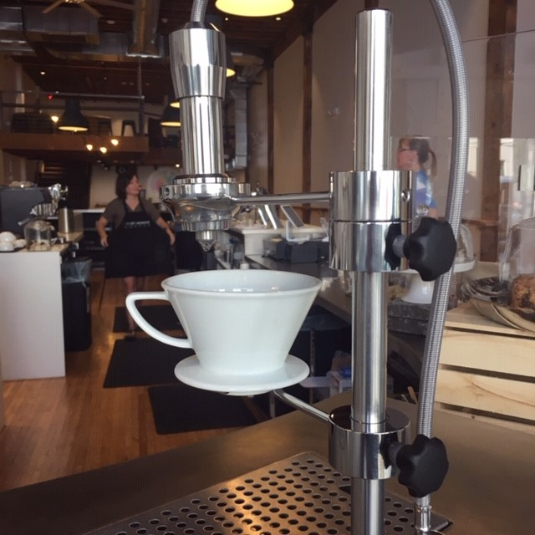
Poetry apps
Poetry – Poetry Foundation
Wings
Pocket Poetry – one poem a day delivered to you (iOS)
Daily Haiku – Cornell University
Word Palette – like refrigerator poetry (iOS)
Rhymer’s Block – (iOS)
Poet Assistant – Android

Slide 12
March 8
Learning Targets
Understand different mediums of poetry
Apply analysis techniques to selected poetry
Activities
Poem starter
Watch two videos: “The Joke” and “Shallow”.
Analyze “The Joke” as a class.
Identify poetic devices
Use short handout for questions
Homework
Select your one song and bring back with an explication for Monday – peer check in

Slide 13
Summer

Slide 14
March 11
Learning Targets
Appropriately cite sources in student work
Activities
Child’s poem starter
MLA Review
Work Day
Homework
Read “A Guide to Reading and Interpreting Poetry” for tomorrow

Slide 15
March 12
Learning Targets
Utilize method of poetic analysis
Activities
Complete in class analysis of at least one poem.
HW
Two Big 6 analyses need to be complete by tomorrow.

Slide 16
March 13
The Poetic Object
In your groups, examine your assigned photo for 2-3 minutes noting color, shape, shading, subject.
Each individual will silently write down a list of all that he or she sees.
Round Robin: Each person will share this or her list paring it down to 10 “best” words as a group. You will end up with a total of 40 words per group.
Your group will be given a handout with a structure using only your 40 words. Some may use all of the words. Others will use fewer.
Be ready to present at the end of the class period.

Slide 18
March 14
Learning Target
Understand the use and purpose of imagery in poetry (literature)
Activity
Six Room poem – This is the one you can use in your anthology.
Six Room Poem Instructions
First, take a piece of blank paper and divide it into six parts or rooms. You can draw this if you wish.

Slide 19
March 14
Room Number 1
Think of something that you have seen outside that is amazing, beautiful or interesting that has just stick in your mind. Close your eyes and try to see it as clearly as a photograph. Notice all the details about it. Describe it as accurately as you can. Don’t think about writing a poem; try to describe your object as specifically.

Slide 20
March 14
Room Number 2
For room two, think about the same object/image but instead think about the quality of light. For example: Is the sun bright? Is it dull or flat? Are there shadows? Is it dark? You can also describe colors here.

Slide 21
March 14
Room Number 3
Picture the same object/image and focus on the sounds. Are there any voices? Rustling of leaves? Sound of rain? If it’s silent – what kind of silent? Empty? Lonely? Peaceful?
Room Number 4
Write down any questions you have about the image. Is there anything you want to know more about? Wonder about?

Slide 22
March 14
Room Number 5
Write down any feelings you have about this same object/image.
Room Number 6
Look over the five ‘rooms” you have already created and select one word, question, phrase or sentence that feels important and repeat it three times.
Read over what you wrote in the six rooms and create a poem. You can rearrange rooms, eliminate – anything.

Slide 23
March 15
Learning Targets
Understand connections between seasons and poetic imagery
Activities
Sonnet 18 starter
Poetic devices and prompts for analysis
Non-fiction/fiction examples
Homework
“No one has ever changed his life because of a poem or a song?”
Yay or nay? Be ready to vote on Monday.

Slide 24
Fall

Slide 25
March 18
Learning targets
Understand author’s purpose in poetry
Activities
Post it vote on Friday’s question
Dickinson and stevens’ poems examined; “the traveling onion”
TPCASST analysis
HW
You should be mid-ay through the analyses of all poems/works; all poems should have already been collected and written.

Slide 26
March 19
WRITER’S BLOCK DAY…
ASSISTANCE WITH WRITING OR COMPILATION IN GROUPS OR AS INDIVIDUALS

Slide 27
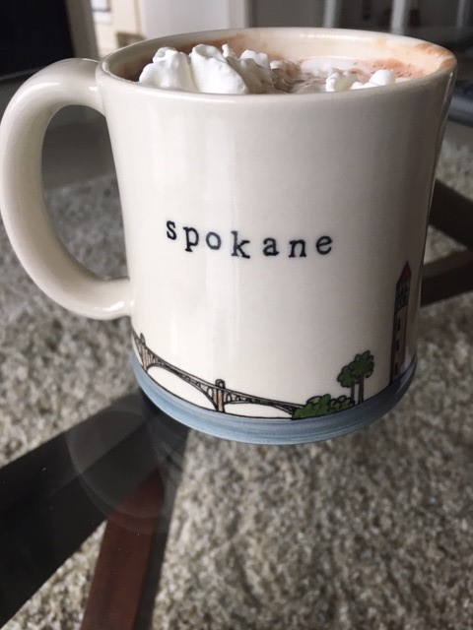
March 20
IN CLASS WORK DAY.
PENCIL BOXES CAN BE CHECKED OUT FROM THE LIBRARY FOR CLASSROOM USE.

Slide 28
Winter

Slide 29
March 21
NATIONAL POETRY DAY!
18 SHORT POEM STARTER
CONTINUE IN CLASS WORK

Slide 30
March 22
Celebration!

